Slide 1

TRANSFORM YOUR LIFE, TRANSFORM YOUR TEAM!
8 ACTIONS TO LEAD BY EXAMPLE
Kansas City Developers Conference 6.24.2016
#KCDC16
#Entrepreninja #KCDC16

Slide 2

Christina Aldan, TEDx Speaker and Entrepreninja
@luckygirliegirl
IAmAGoodMix.com LG@LGDesigns.co 702.900.3419
#Entrepreninja #KCDC16

Slide 3

#Entrepreninja #KCDC16

Slide 4


Slide 5
SO WHO AM I?
They call me Luckygirl
My job title is: Entrepreninja
#Entrepreninja #KCDC16

Slide 6

SO WHO AM I?
Founder of LG Designs, Brand Consulting
Chief Marketing Officer, PrayerSpark
Business Development Trainer, Team Healthy Life
Board Member, The Never Give Up Foundation
Technology Advisor, Asian Community Development Council
Advisory Board Member High Schools Active Member of OCA Las Vegas Former Co-managing Director, Girls in Tech, Las Vegas
Advisory Board Member High Schools
Active Member of OCA Las Vegas
Co-managing Director, Girls in Tech, Las Vegas
#Entrepreninja #KCDC16

Slide 7
Leaders Transform Reality
“As a leader, these attributes - confidence, perseverance, work ethic and good sense - are all things I look for in people. I also try to lead by example and create an environment where good questions and good ideas can come from anyone.”
~Heather Bresch
#Entrepreninja #KCDC16

Slide 8
WHAT LEADERSHIP ISN'T
These things do NOT make a leader:
Authority or Power
Titles
Charisma
Management
Extroverted Personalities
Influence – ex. A robber with a gun
Followers – ex. An army captain
High Intelligence (IQ)
#Entrepreninja #KCDC16

Slide 9
WHAT MAKES A LEADER?
Someone who uses their social influence to inspire positive action in others
Has a high degree of Emotional Intelligence (EQ)
Someone who empowers, rather than dictates
A person who leads by example
“A life well-lived is the best gift you can give.”
#Entrepreninja #KCDC16

Slide 10
8 ACTION STEPS TO TAKE NOW
#Entrepreninja #KCDC16

Slide 11
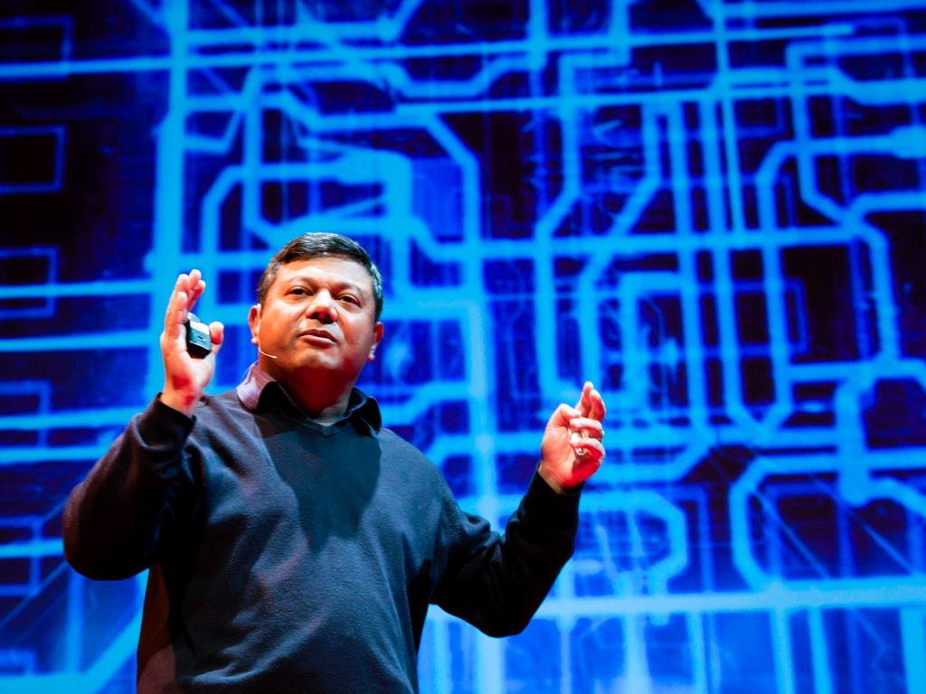
1. Share Your Passion
#Entrepreninja #KCDC16
cc: theqspeaks - https://www.flickr.com/photos/83261600@N00

Slide 12


Tony Hsieh, The Downtown Project
#Entrepreninja #KCDC16

Slide 13

2. Mentorship
#Entrepreninja #KCDC16
cc: jdlasica - https://www.flickr.com/photos/36521958135@N01

Slide 14
Mentor/Mentee Relationship
Non-Traditional vs. Traditional
Meet 1-on-1 once a year for coffee
Follow their tips and suggestions by regularly following their books, newsletters, blog and social media
Quarterly Skype call
Different age, industry, gender, religion
Signed agreement and timeline (optional)
#Entrepreninja #KCDC16

Slide 15
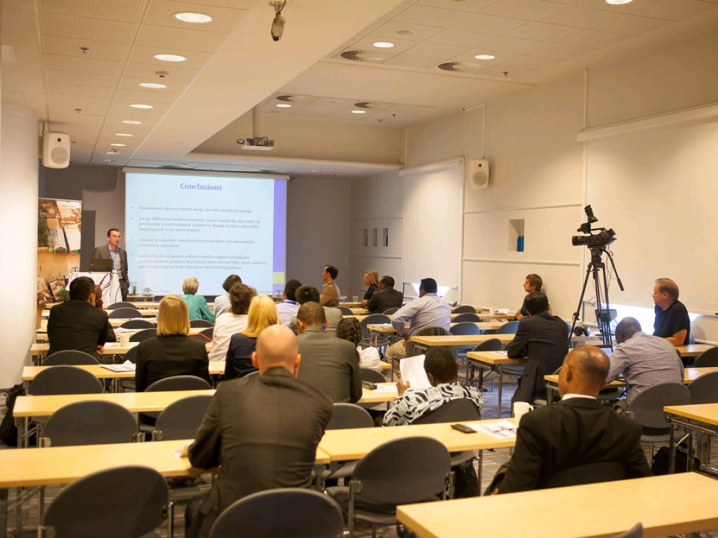
3. Submission Policies
#Entrepreninja #KCDC16
cc: UNU-WIDER - https://www.flickr.com/photos/63315541@N05

Slide 16
Process for Submitting Ideas
Web-based portal
Quarterly Calls for Innovation
Hackathons
Themed focus – Kandy.io ex: “The Hackathon of Ridiculous Things”
Designathons
Front-end Engagement & UI/UX
Innovation Challenges
*Not meant to replace Research & Development
#Entrepreninja #KCDC16

Slide 17
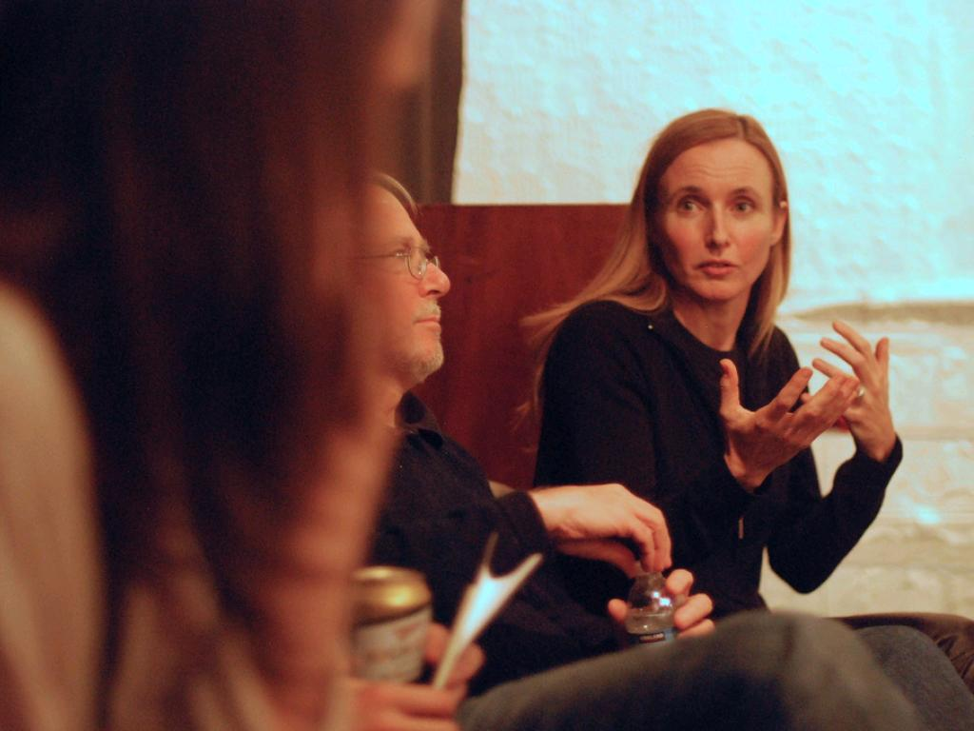
4. Communication
#Entrepreninja #KCDC16
cc: uniondocs - https://www.flickr.com/photos/8207752@N03

Slide 18
Improve Communication
Open-door policy
Employee reviews
Comment box
Discussion Forum – ex. SynShop Makers
Closed social silo – ex. PrayerSpark Hospice App
#Entrepreninja #KCDC16

Slide 19
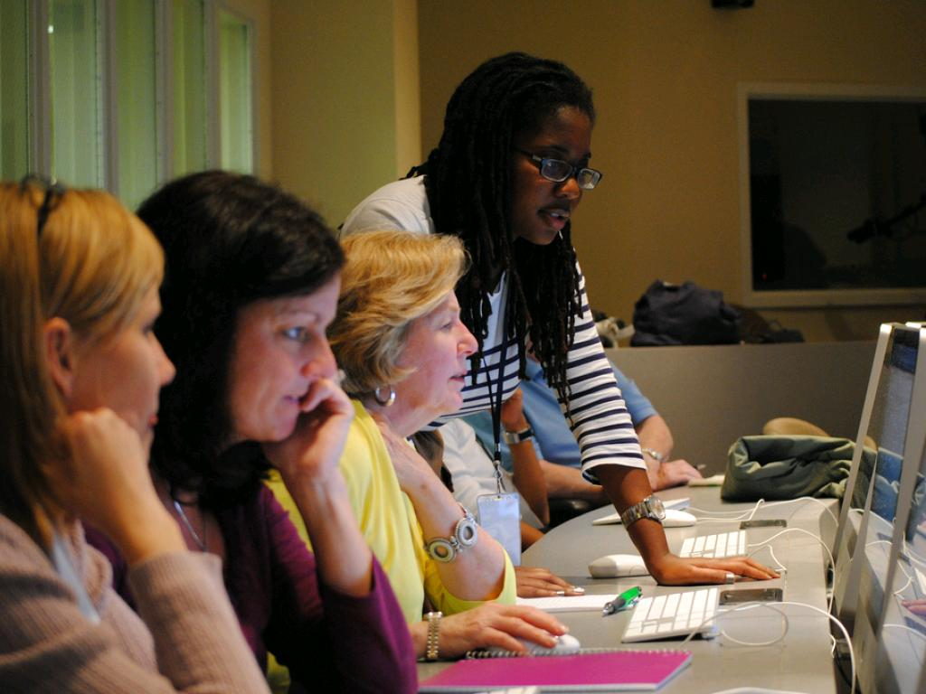
5. Skillshare
#Entrepreninja #KCDC16
cc: Knight Foundation - https://www.flickr.com/photos/9133668@N08

Slide 20
Skillshare Opportunities
Internal Workshops
10% interdepartmental projects – ex. Zappos
Activity library
Online learning credits – ex. Treehouse, Pluralsite, Lynda, Udemy
*Cautionary mediocrity warning
#Entrepreninja #KCDC16

Slide 21

6. Emotional Intelligence (EQ)
#Entrepreninja #KCDC16

Slide 22
4 Components of Emotional Intelligence
Mindfulness of Self
Mindfulness of Others
Self-Management
Relationship Management
Build Your Tribe – bit.ly/IAmAGoodMix
#Entrepreninja #KCDC16

Slide 23
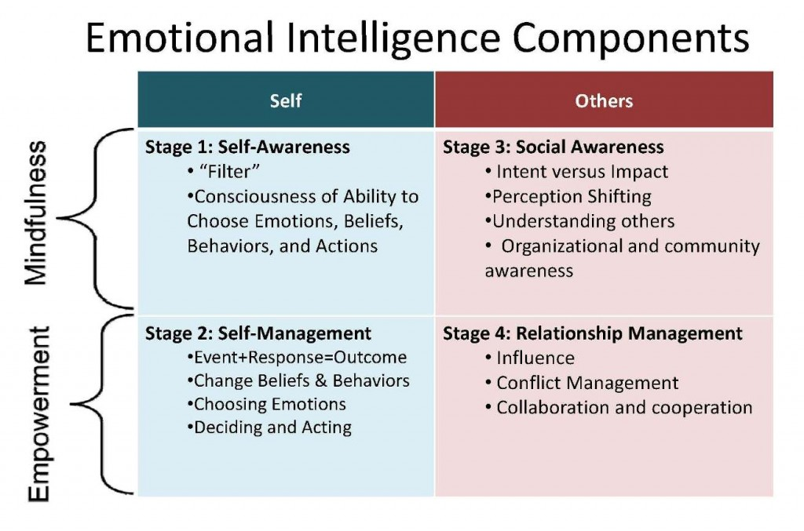
4 Components of Emotional Intelligence
#Entrepreninja #KCDC16

Slide 24

7. Infrastructure
#Entrepreninja #KCDC16
cc: ataferner - https://www.flickr.com/photos/47962459@N00

Slide 25
Create Infrastructure
Organize the team
Define goals
Identify parameters, limitations, best practices
Align key players – clear communication & feedback with senior team
Foster demonstrations
Celebrate wins
Plan to scale (or not) – have a clear timeline
#Entrepreninja #KCDC16

Slide 26
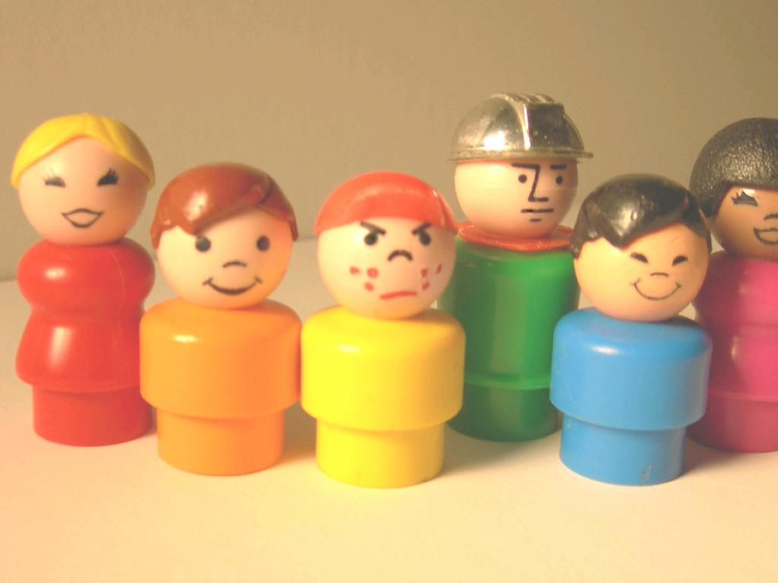
8. Identify Diversity
#Entrepreninja #KCDC16
cc: ChildOfAtom - https://www.flickr.com/photos/45287505@N00

Slide 27
Take Advantage of Diversity
Become a Talent Detective
Assess the best talents on your team
Take advantage of a variety of viewpoints
Motivate using their passions
Feedback
Implement hiring diversity policies that hire the most qualified person for the job
#Entrepreninja #KCDC16

Slide 28
Leaders Empower
“A leader is best when people barely know he exists, when his work is done, his aim fulfilled, they will say: we did it ourselves.”
~Lao Tzu
#Entrepreninja #KCDC16

Slide 29
Questions?
#KCDC16
Christina Aldan TEDx Speaker and Entrepreninja
@luckygirliegirl
IAmAGoodMix.com
LG@LGDesigns.co
702.900.3419
#Entrepreninja #KCDC16

